Slide 1
Online EHS Training
General & Local Exhaust Ventilations in Laboratories
2023

Slide 2
LEARNING OBJECTIVE
Upon completion of this training course, participants will be able to:
Outline the importance and specifics of laboratory ventilation
Discuss the different types of Local Exhaust Ventilations.
Discuss usage and functions of fume hoods
Apply safe work practice while using fume hoods

Slide 3
INTRODUCTION
Laboratory ventilation is the single most important factor used to protect people from airborne hazards. Ventilation systems can be separated into two categories:
Room (general) ventilation
Local exhaust ventilation

Slide 4


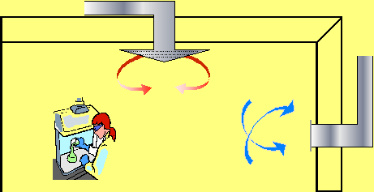
ROOM (GENERAL) VENTILATION
Laboratory room ventilation is comprised of an air supply and an exhaust system. The supply system introduces clean air into the room and the exhaust removes contaminated air.
Laboratory
Supply Air
Return Air
Based on the volume of space in a laboratory and the volume of air exhausted, an exchange rate can be determined. This exchange rate is expressed as – air exchanges per hour (ACH/hr).
The higher the exchange rate, the faster airborne contaminants are exhausted or eliminated.
Air exchange rates for laboratories range from 6 to 12 per hour based on chemical use.
Labs air exchange rate : 6
98.4% of the air will be exchanged by fresh air within one hour.

Slide 5
ROOM (GENERAL) VENTILATION continues…
Laboratories should exhaust air at a higher rate than supplied so that the room is under negative pressure to surrounding rooms and corridors.
Negative pressure prevents air from migrating from the laboratory into adjacent areas.
Most laboratory ventilation systems are designed to function with doors and windows closed. Therefore, laboratory doors should not be propped open and windows should remain shut.

Slide 6
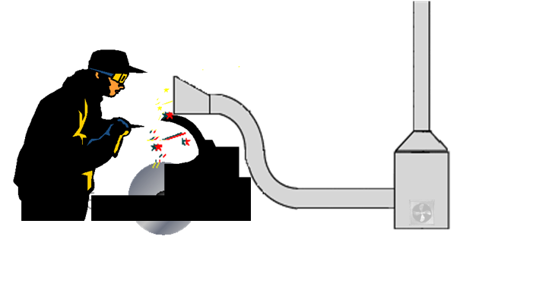
LOCAL EXHAUST VENTILATION
Local exhaust ventilation is an engineering control used to capture low risk airborne contaminates at or near the source and remove them away from the work place.
Local exhaust ventilation systems capture or contain contaminants at their source.
These contaminants are typically exhausted through a roof stack.
Examples of local exhaust ventilation;
- Slotted hood
- Canopy hood
- Snorkel
Glove box
Chemical fume hood

Slide 7
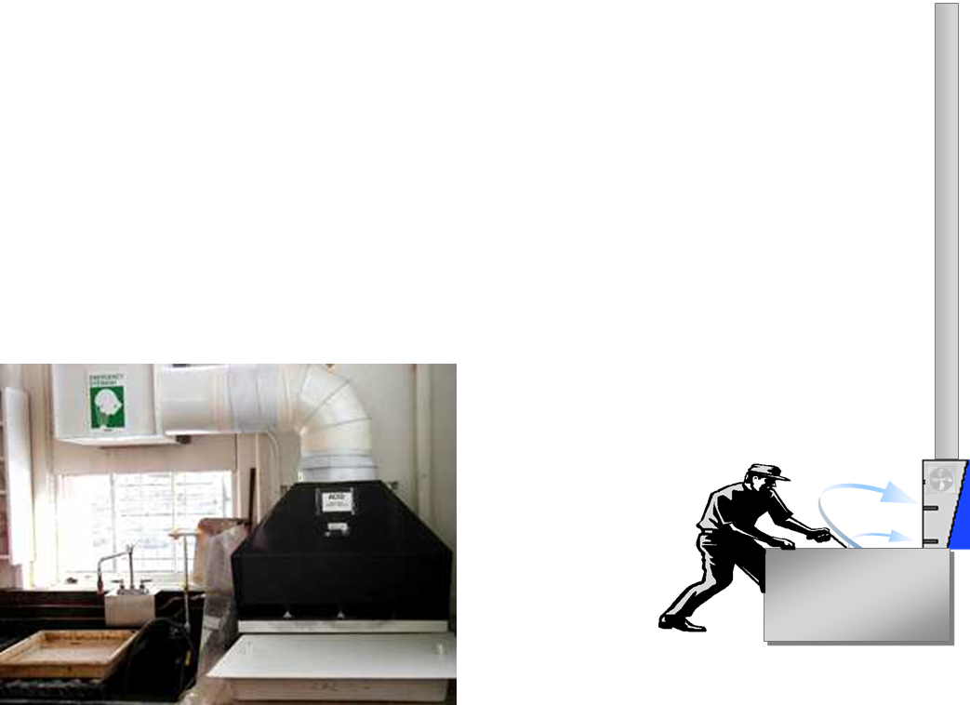
SLOTTED HOOD
Used to capture less toxic vapors and gases used on a counter top. Air is drawn across the work surface and exhausted through the slots.
! The biggest drawback is that the capture area is limited, typically within 24 inches of the slots.

Slide 8
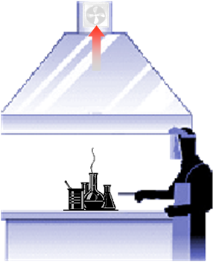
CANOPY HOOD
Used to capture less toxic vapors and gases that are heated and rise. The canopy is located over the source of emission.
! The biggest drawback is that the canopy does not capture contaminates unless they rise into the hood.

Slide 9
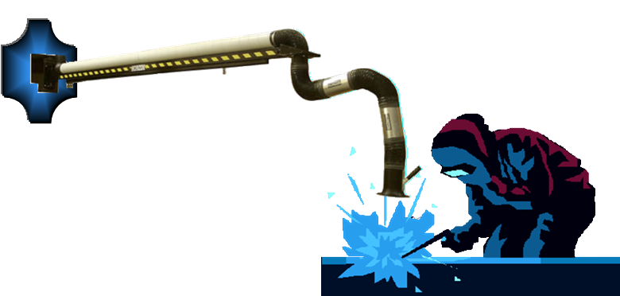
SNORKELS
Captures less toxic substances located next to the intake. The main benefit is that it can be moved or located as needed.
! The biggest drawback is that the capture area is small, typically within 24 inches of the intake opening.

Slide 10
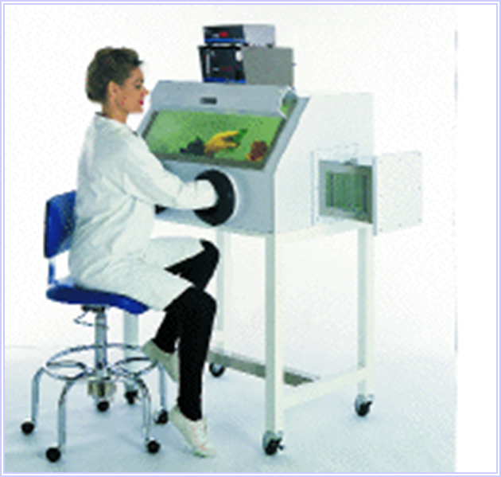
GLOVE BOX
Glove boxes are sealed containers with gloves built into their walls so that samples can be worked on while being completely separated from the outside environment.
! The biggest drawback is that the work area is small and the manipulation of materials can be difficult.

Slide 11
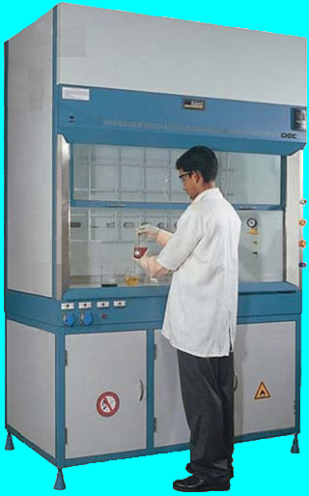
CHEMICAL FUME HOODS
The primary safety system is used to protect the laboratory worker from exposure to chemical vapors, fumes, and toxic gases.
It also provides some protection to laboratory workers from fires and explosions.
The facilities department evaluates fume hoods on an annual basis.
If you suspect your fume hood is not working properly, contact FM helpdesk at FMHelpdesk@ku.ac.ae
Types of fume hoods;
- Conventional Fume Hood
- Bypass Fume Hood
- Auxiliary Air Fume Hood
- Walk–in Hood
Airflow monitor
Sash
Baffles
Gas & Water connections
Chemical storage cabinets
Airfoil

Slide 12
CHEMICAL FUME HOOD PERFORMANCE
A fume hood that functions properly will meet the following criteria:
The face velocity will average 0.4-0.8 meter per second with the sash open 18 inches
Air flow will flow evenly across the work surface
The hood will be structurally sound with no cracks in the safety glass
Sashes will slide properly, no parts will be missing and baffles will be open

Slide 13
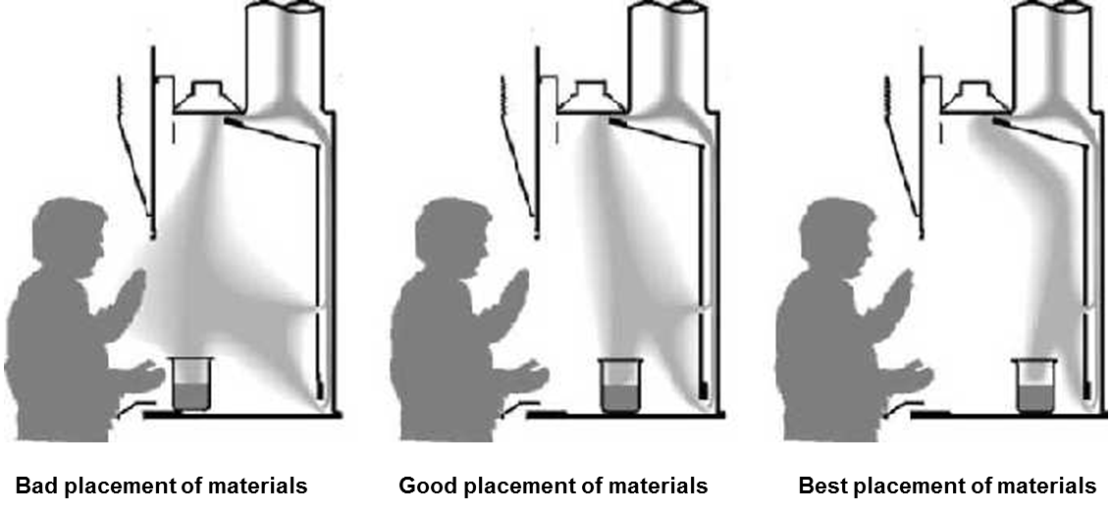
FUME HOOD- SAFE WORK PRACTICES
Mark a line with tape 6 inches behind the sash and keep all chemicals and equipment behind that line during experiments.
Provide catch basins for containers that could break or spill, to minimize the spread of spilled liquids.
Keep the sash completely lowered any time an experiment is in progress and the hood is unattended.
Lowering the sash not only provides additional personal protection but also
results in significant energy conservation.
Never use a hood to control exposure to hazardous substances without first verifying that it is operating properly.

Slide 14
FUME HOOD- SAFE WORK PRACTICES continues…
Every day, check flow indicators to make sure the fume hood is functioning properly
If you have an older hood that has not been upgraded with a flow indicator, hang tissue paper from the sash and observe the direction and strength of flow
Contact or raise a Help Desk request, if the hood is not functioning properly
Know the physical, chemical and toxicological properties of all chemicals you use
Conduct all operations that generate contaminates at or above OSHA exposure limits inside the fume hood
Visually inspect the baffles (openings at the top and rear of the hood) to be sure that the slots are open and unobstructed.
Do not block baffle slots. If large equipment must be placed in the hood, put it on blocks to raise it approximately 2 inches above the surface so that air may pass beneath it.
Keep laboratory doors closed, except when lab design requires the doors to be open

Slide 15
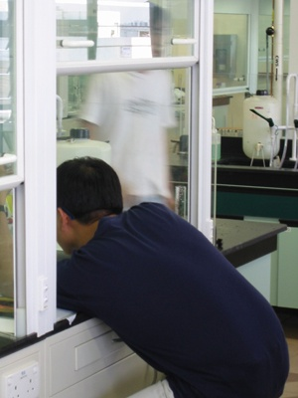

FUME HOOD- SAFE WORK PRACTICES continues…
13. Do not store apparatus or chemicals in the hood.
14. Do not place your head or any unprotected part of your body inside the hood when contaminates are present / generated.
15. Minimize foot traffic and rapid movement past the face of the fume hood (to prevent air turbulence).
16. Do not remove the sash or safety glass except when necessary for apparatus set-up.
17. Do not use a fume hood with a damaged sash
18. Keep the fume hood clean and free of debris

